Slide 1
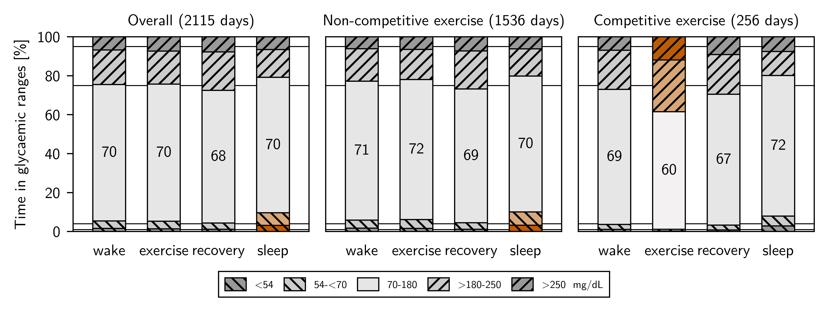
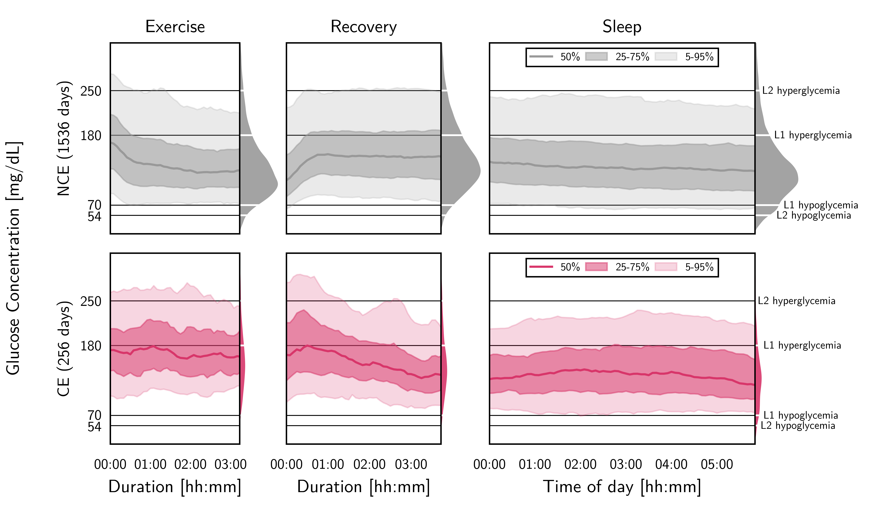
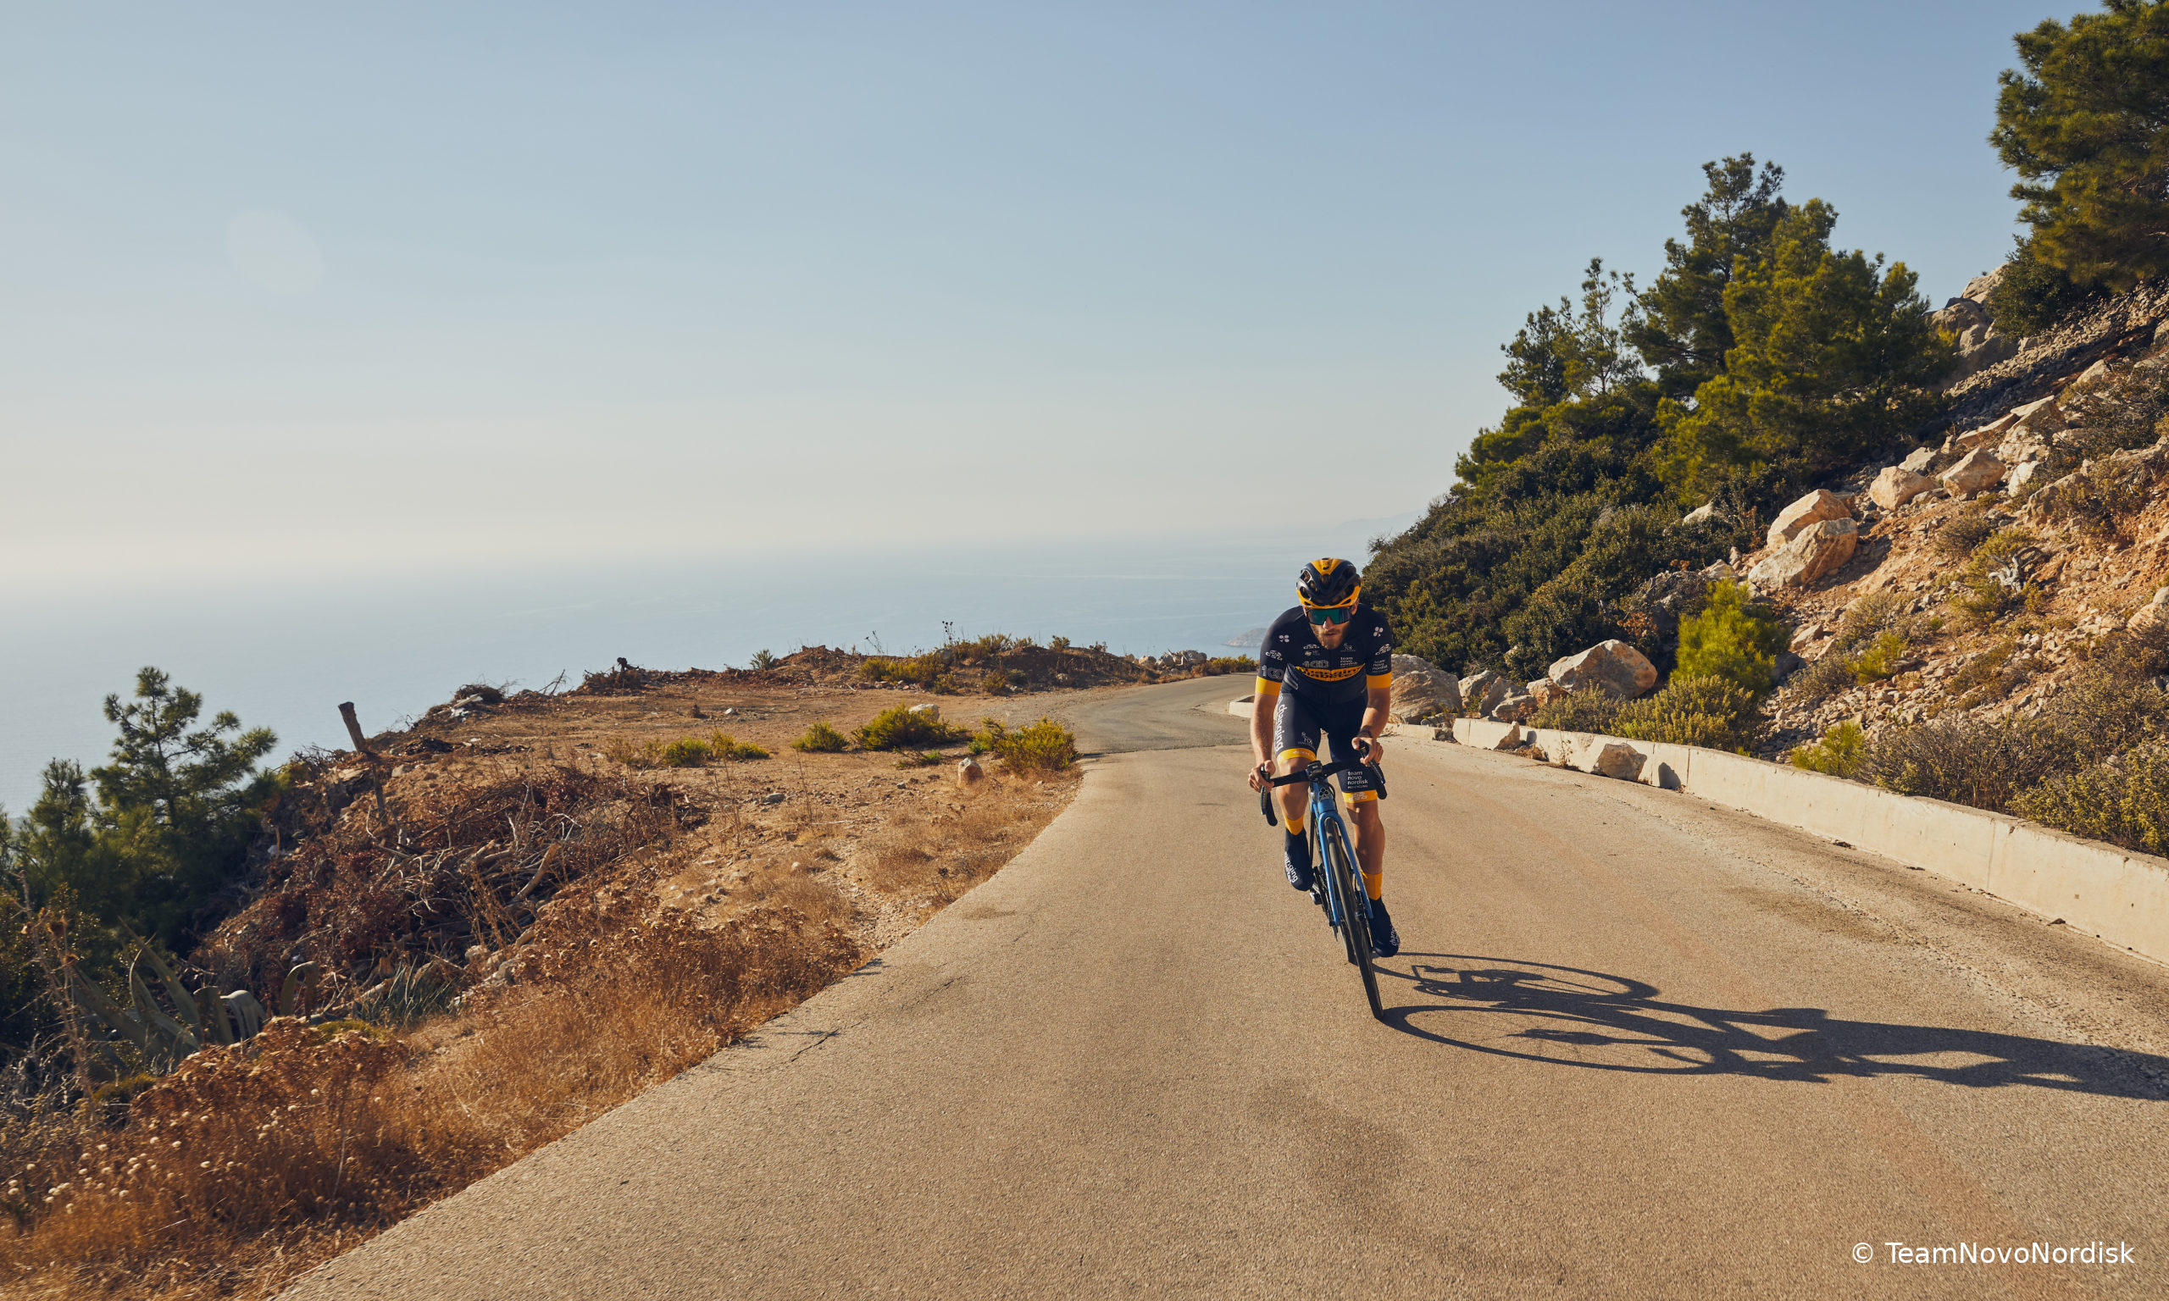









Glycemic Patterns of Male Professional Athletes With Type 1 Diabetes During Exercise, Recovery and Sleep: Retrospective, Observational Study Over an Entire Competitive Season
Eva van Weenen, MSc¹; Nicolas Banholzer, PhD²; Simon Föll, MSc¹; Thomas Zueger, MD^{3,4}; Federico Y. Fontana, PhD^{3,5,6}; Kristina Skroce, MSc^{7,8}; Charlotte Hayes, MMSc⁵; Mathias Kraus, PhD⁹; Stefan Feuerriegel, PhD¹⁰; Vera Lehmann, MD³; Sam N. Scott, PhD^{5,}*; Felix Wortmann, PhD^{11,}*; Christoph Stettler, MD^{3,}*
* Joint last author; 1 D-MTEC, ETH Zurich; 2 ISPM, University of Bern; 3 UDEM, Bern University Hospital, University of Bern; 4 Kantonsspital Olten; 5 Team Novo Nordisk; 6 CeRiSM, University of Verona; 7 Faculty of Medicine, University of Rijeka; 8 DNBM, University of Verona; 9 WiSo, FAU Erlangen-Nürnberg; 10 AI-BWL, LMU Munich; 11 ITEM, University of St. Gallen
1 Introduction
3 Results
Reports on endurance exercise of prolonged duration in people with type 1 diabetes (T1D) have only been provided over a short period of time. Our objective is to analyze the glycemic control of professional athletes with type 1 diabetes over a competitive season.
Comparison of glycemic control with clinical targets
Mean age was 25.6±4.4 years, duration of T1D was 10.4±4.9 years, and HbA_{1c} was 6.7±0.5% (50±5 mmol/mol). All participants used a basal-bolus insulin regimen administered via multiple daily injections (MDI). The participants cycled on 280.8±28.1 days during the season, of which 34.7±15.3 days were during CE.
2 Research Design and Methods
Overall, time in range (70–180 mg/dL) was 70.0±13.7%, time in hypoglycemia (<70 mg/dL) was 6.4±4.7%, and time in hyperglycemia (>180 mg/dL) was 23.6±12.5%.
During NCE days, time in hypoglycemia was increased overnight (10.1±7.4% vs. 4%, p=0.008).
CE days revealed an increased time in hyperglycemia (25.2±12.5% vs. 25%, p=0.012). Time in hyperglycemia during CE was higher than during NCE (38.5±12.9% vs. 21.9±13.9%, p<0.001), exceeding consensus targets (p=0.003).
In a retrospective observational study, we analyzed the continuous glucose monitoring (CGM) data of 12 professional male cyclists with T1D during exercise, recovery and sleep on days with competitive exercise (CE) and non-competitive exercise (NCE), following consensus guidelines¹.
The analysis was two-fold:
Comparison of glycemic control with clinical targets²
Comparison of glycemic control during CE with NCE
Comparison of glycemic control during CE with NCE
4 Conclusion and Discussion
We provide insights into the glycemic control of professional athletes with type 1 diabetes over a competitive season. While overall glycemic control was within range, the substantial challenges associated with the life of a professional athlete with type 1 diabetes may explain that consensus targets were not always reached. Specific emphasis should be put on intensified monitoring and treatment during competitions and overnight periods, not only to further improve training adaptation, but to reduce short-term and long-term risks for athletes with type 1 diabetes.
References
Danne T, et al. (2017) International consensus on use of continuous glucose monitoring. Diabetes Care 40:1631-1640
Battelino T, et al. (2019) Clinical targets for continuous glucose monitoring data interpretation: Recommendations from the international consensus on time in range. Diabetes Care 42:1593-1603
© Team Novo Nordisk

